Slide 1

OPERATING SYSTEMS
Memory Management

Slide 2
Memory Management
Ideally programmers want memory that is
  large
  fast
  non volatile
Memory hierarchy
  small amount of fast, expensive memory – cache
  some medium-speed, medium price main memory
  Gigabytes slow, cheap disk storage

Slide 3
Background
Program must be brought (from disk) into memory and placed within a process for it to be run
Main memory and registers are only storage CPU can access directly
Memory unit only sees a stream of addresses + read requests, or address + data and write requests
Register access in one CPU clock (or less)
Main memory can take many cycles, causing a processor stall
Cache sits between main memory and CPU registers
Protection of memory required to ensure correct operation

Slide 4
Basic Hardware
Each process has a separate memory space
We need to defined the range of legal addresses that a process may access.
This is ensured by two registers:
Base Register: Holds the smallest legal physical memory address.
Limit Register: specifies the size of the range.
For e.g. if the base register holds 1250 and limit register is 356, then the program can access all addresses from 1250 to 1605(inclusive)

Slide 5

Base and Limit Registers
A pair of base and limit registers define the logical address space
CPU must check every memory access generated in user mode to be sure it is between base and limit for that user

Slide 6

Hardware Address Protection

Slide 7
Logical vs. Physical Address Space
  Logical address – generated by the CPU; also referred to as virtual address
  Physical address – address seen by the memory unit
Logical and physical addresses are the same in compile-time and load-time address-binding schemes; logical (virtual) and physical addresses differ in execution-time address-binding scheme
Logical address space is the set of all logical addresses generated by a program
Physical address space is the set of all physical addresses generated by a program

Slide 8
Memory-Management Unit (MMU)
Hardware device that at run time maps virtual to physical address
To start, consider simple scheme where the value in the relocation register is added to every address generated by a user process at the time it is sent to memory
  Base register now called relocation register
The user program deals with logical addresses; it never sees the real physical addresses.

Slide 9

Dynamic relocation using a relocation register

Slide 10
Memory Management Techniques
There are two Memory Management Techniques: Contiguous, and Non-Contiguous.
In Contiguous Technique, executing process must be loaded entirely in main-memory.
Contiguous Technique can be divided into:
  Fixed (or static) partitioning
  Variable (or dynamic) partitioning

Slide 11
Fixed Partitioning:
The earliest and one of the simplest technique which can be used to load more than one processes into the main memory is Fixed partitioning or Contiguous memory allocation.
In this technique, the main memory is divided into partitions of equal or different sizes.
The operating system always resides in the first partition while the other partitions can be used to store user processes.
In fixed partitioning,
  The partitions cannot overlap.
  A process must be contiguously present in a partition for the execution.

Slide 12
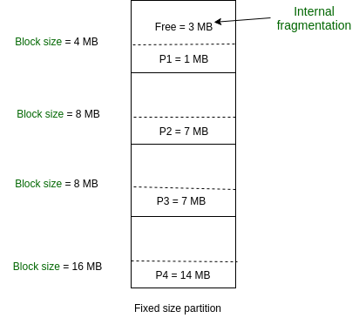
Disadvantages
Internal Fragmentation
If the size of the process is lesser then the total size of the partition then some size of the partition get wasted and remain unused. This is wastage of the memory and called internal fragmentation.
.
External Fragmentation
The total unused space of various partitions cannot be used to load the
processes even though there is space available but not in the contiguous form.

Slide 13
Disadvantages
Limitation on the size of the process
Process of size greater than size of partition in Main Memory cannot be accommodated.
.
Limitation on Degree of Multiprogramming:
Suppose if there are n1 partitions in RAM and n2 are the number of processes, then condition n2<=n1 must be fulfilled.

Slide 14
Dynamic Partitioning
Dynamic partitioning tries to overcome the problems caused by fixed partitioning.
In this technique, the partition size is not declared initially.
It is declared at the time of process loading.
The first partition is reserved for the operating system.
The remaining space is divided into parts.
The size of each partition will be equal to the size of the process.
The partition size varies according to the need of the process so that the internal fragmentation can be avoided.

Slide 15
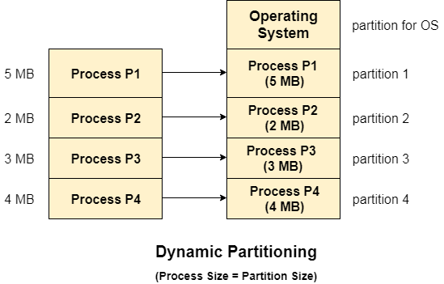
Advantages of Dynamic Partitioning over fixed partitioning
No Internal Fragmentation
there will not be any unused
remaining space in the partition.
No Limitation on the size of the process
Degree of multiprogramming is dynamic
Due to the absence of internal fragmentation, there will not be any unused space in the partition hence more processes can be loaded in the memory at the same time.

Slide 16

Disadvantages
External Fragmentation
Absence of internal fragmentation doesn't mean that there will not be external fragmentation.

Slide 17
Partitioning Algorithms
How to satisfy a request of size n from a list of free holes?
First-fit: Allocate the first hole that is big enough
Best-fit: Allocate the smallest hole that is big enough; must search entire list, unless ordered by size
  Produces the smallest leftover hole
Worst-fit: Allocate the largest hole; must also search entire list
  Produces the largest leftover hole
First-fit and best-fit better than worst-fit in terms of speed and storage utilization

Slide 18
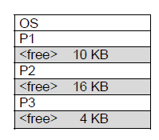
Example
Consider the following memory map and assume a new process P4 comes with a memory requirement of 3 KB. Locate this process.
a. First fit algorithm allocates from the 10 KB block.
b. Best fit algorithm allocates from the 4 KB block.
c. Worst fit algorithm allocates from the 16 KB block

Slide 19
Que
Given five memory partitions of 100 KB, 500 KB, 200 KB, 300 KB, and 600 KB (in order),how would each of the first-fit, best-fit, and worst-fit algorithms place processes of 212 KB, 417KB, 112 KB, and 426 KB (in order)?Which algorithm makes the most efficient use of memory?
100
500
200
300
600

Slide 20
a. First-fit:
1. 212K is put in 500K partition
2. 417K is put in 600K partition
3. 112K is put in 288K partition (new partition 288K = 500K
−212K)
4. 426K must wait
b. Best-fit:
1. 212K is put in 300K partition
2. 417K is put in 500K partition
3. 112K is put in 200K partition
4. 426K is put in 600K partition
c. Worst-fit:
l. 212K is put in 600K partition
2. 417K is put in 500K partition
3. 112K is put in 388K partition
4. 426K must wait
In this example, best-fit turns out to be the best.

Slide 21
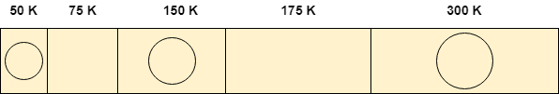
Q. Process requests are given as;
25 K , 50 K , 100 K , 75 K
Determine the algorithm which can optimally satisfy this requirement.
a. First Fit algorithm
b. Best Fit Algorithm
c. Neither of the two
d. Both of them
In the question, there are five partitions in the memory. 3 partitions are having processes inside them and two partitions are holes.
Our task is to check the algorithm which can satisfy the request optimally.

Slide 22
Fragmentation
External Fragmentation – total memory space exists to satisfy a request, but it is not contiguous
Internal Fragmentation – allocated memory may be slightly larger than requested memory; this size difference is memory internal to a partition, but not being used

Slide 23
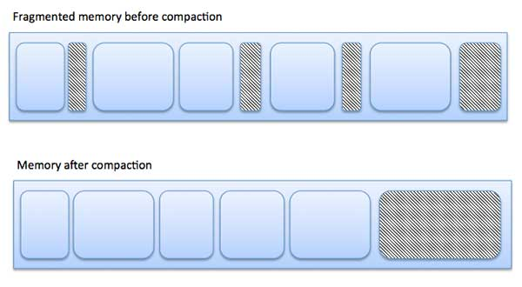
Fragmentation (Cont.)
Use compaction to minimize the probability of external fragmentation.
In compaction, all the free partitions are made contiguous and all the loaded partitions are brought together.
Reference:
https://www.tutorialspoint.com/operating_system/os_memory_management.htm

Slide 24
Swapping
A process can be swapped temporarily out of memory to a backing store, and then brought back into memory for continued execution
  Total physical memory space of processes can exceed physical memory
Backing store – fast disk large enough to accommodate copies of all memory images for all users;
Roll out, roll in – swapping variant used for priority-based scheduling algorithms; lower-priority process is swapped out so higher-priority process can be loaded and executed
Major part of swap time is transfer time; total transfer time is directly proportional to the amount of memory swapped
System maintains a ready queue of ready-to-run processes which have memory images on disk

Slide 25

Schematic View of Swapping

Slide 26
Paging
In Operating Systems, Paging is a storage mechanism used to retrieve processes from the secondary storage into the main memory in the form of pages.
Pages of the process are brought into the main memory only when they are required otherwise they reside in the secondary storage.

Slide 27
Paging
Physical address space of a process can be noncontiguous;
  Avoids external fragmentation
  Avoids problem of varying sized memory chunks
Divide physical memory into fixed-sized blocks called frames
  Size is power of 2, between 512 bytes and 16 Mbytes
Divide logical memory into blocks of same size called pages
Keep track of all free frames

Slide 28
To run a program of size N pages, need to find N free frames and load program
Set up a page table to translate logical to physical addresses
Backing store likewise split into pages
Still have Internal fragmentation

Slide 29
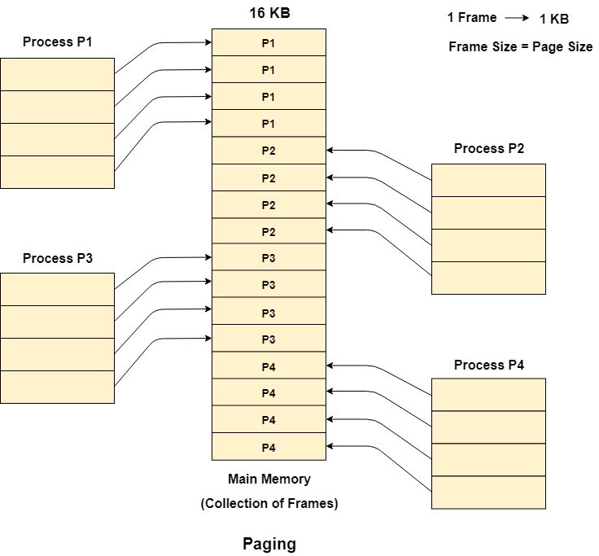
Assume main memory size 16 Kb and Frame size is 1 KB
P1, P2, P3 and P4 of 4 KB each

Slide 30
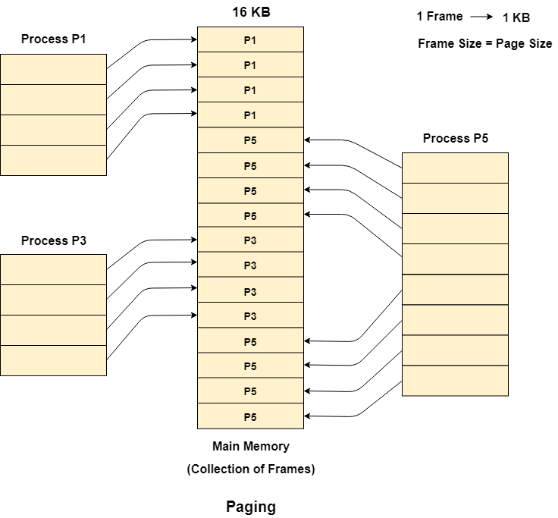
Consider that, P2 and P4 are moved to waiting state after some time.

Slide 31

Address Translation Scheme
Address generated by CPU is divided into:
  Page number (p) – used as an index into a page table which contains base address of each page in physical memory
  Page offset (d) – combined with base address to define the physical memory address that is sent to the memory unit
  For given logical address space 2^{m} and page size 2^{n}

Slide 32
Terminology
Logical Address or Virtual Address (represented in bits): An address generated by the CPU
Logical Address Space or Virtual Address Space( represented in words or bytes): The set of all logical addresses generated by a program
Physical Address (represented in bits): An address actually available on memory unit
Physical Address Space (represented in words or bytes): The set of all physical addresses corresponding to the logical addresses

Slide 33
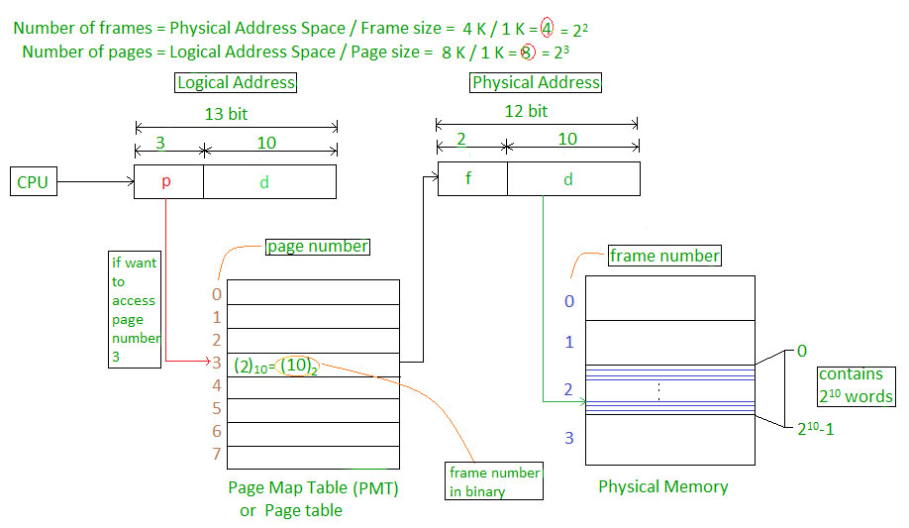
7: Deadlocks

Slide 34
Logical Address = 13 bits
Physical Address = 12 bits
Page size = frame size = 1 K words
Logical Address Space?
Physical Address Space
How many pages?
How many frames?
What is the value of p
and d?
2^13 bytes or words
2^12 bytes or words
8
4
3, 10

Slide 35

Paging Model of Logical and Physical Memory
Page No
Frame No
Logical address space=16 bytes=2^4
Physical Address space=32 bytes
Page size=4 bytes=2^2
Logical Address? 4 bits
Physical address? 5 bits
No of pages=16/4=4 pages
No. of frames=32/4=8 frames
2
2

Slide 36

Paging Hardware

Slide 37

Paging Example
Logical address 0-> 0000 will map in physical address 20
Logical address 3->physical 23
Logical address 10->physical address 6
Logical address 13-> physical address 9
Logical address 4-> physical address 24
n=2 and m=4 32-byte memory and 4-byte pages

Slide 38
Paging (Cont.)
Calculating internal fragmentation
  Page size = 2,048 bytes
  Process size = 72,766 bytes
  35 pages + 1,086 bytes
  Internal fragmentation of 2,048 - 1,086 = 962 bytes
  So small frame sizes desirable?

Slide 39

Paging Hardware With TLB

Slide 40
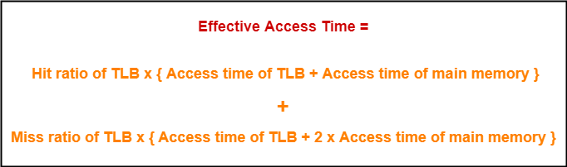

Slide 41
Q1
A paging scheme uses a Translation Lookaside buffer (TLB). A TLB access takes 10 ns and a main memory access takes 50 ns. What is the effective access time (in ns) if the TLB hit ratio is 90% and there is no page fault?
A.54
B.60
C.65
D. 75
Option C is correct

Slide 42
Q2
A paging scheme uses a Translation Lookaside buffer (TLB). The effective memory access takes 160 ns and a main memory access takes 100 ns. What is the TLB access time (in ns) if the TLB hit ratio is 60% and there is no page fault?
54
60
20
75
Option C is correct

Slide 43
Segmentation
Memory-management scheme that supports user view of memory
A program is a collection of segments
A segment is a logical unit such as:
main program
procedure
function
method
object
local variables, global variables
common block
stack
symbol table
arrays

Slide 44
Why Segmentation is required?
Operating system doesn't care about the User's view of the process.
It may divide the same function into different pages and those pages may or may not be loaded at the same time into the memory.
It decreases the efficiency of the system.

Slide 45

User’s View of a Program

Slide 46
Logical View of Segmentation
1
1
4
2
3
4
2
3
user space
physical memory space

Slide 47
Segmentation Architecture
Logical address consists of a two tuple:
<segment-number, offset>,
Segment table – maps two-dimensional physical addresses; each table entry has:
  base – contains the starting physical address where the segments reside in memory
  limit – specifies the length of the segment
Segment-table base register (STBR) points to the segment table’s location in memory
Segment-table length register (STLR) indicates number of segments used by a program;
segment number s is legal if s < STLR

Slide 48

Segmentation Architecture (Cont.)
Since segments vary in length, memory allocation is a dynamic storage-allocation problem
Segment Base Length
0 219 600
What are the physical addressed for the following logical addresses? (a) 0,430

Slide 49
Question
Consider the following segment table:
Segment Base Length
0 219 600
1 2300 14
2 90 100
3 1327 580
4 1952 96
What are the physical addressed for the following logical addresses? (a) 0,430 (b) 1,10 (c) 2,500 (d) 3,400 (e) 4,112

Slide 50
(a) 219 + 430 = 649
(b) 2300 + 10 = 2310
(c) illegal reference; traps to operating system
(d) 1327 + 400 = 1727
(e) illegal reference; traps to operating system

Slide 51
Advantages of Segmentation
No internal fragmentation
Average Segment Size is larger than the actual page size.
Less overhead
It is easier to relocate segments than entire address space.
The segment table is of lesser size as compare to the page table in paging.

Slide 52
Disadvantages
It can have external fragmentation.
it is difficult to allocate contiguous memory to variable sized partition.
Costly memory management algorithms.

Slide 53
Refrences
https://www.gatevidyalay.com/paging-formulas-practice-problems/

